Slide 1


We are on a mission to address the digital skills gap for 10 Million+ young professionals, train and empower them to forge a career path into future tech

Slide 2

TestNG and Its Types
11 APRIL, 2022

Slide 3
Contents
Unit Testing
TestNG Annotations
Types of TestNG Annotations
TestNG Reporting
TestNG Assertions
TestNG Suite & Parallel Execution
TestNG Priority Execution

Slide 4


Unit Testing
Please download pictures in suitable size here and insert them by clicking the symbol above.

Slide 5
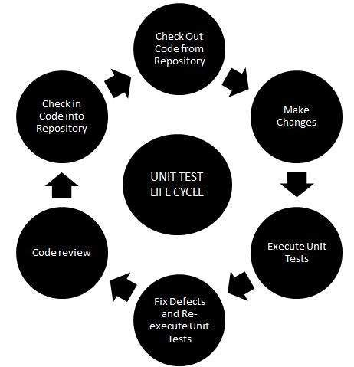
Unit Testing
Unit Testing
Unit Testing is a type if software testing where individual units or components of a software are tested
The purpose is to validate that each unit of the software code performs as expected
Unit Testing is done during the development (coding phase) of an application by the developers.
Unit Tests isolate a section of code and verify its correctness.

Slide 6
Unit Testing and its Advantages
Unit Testing
A unit may be an individual function, method, procedure, module or object.
Advantages of Unit Testing :
Reduces defects in the newly developed features or reduces bugs when changing the existing functionality.
Reduces cost of testing as defects are captured in very early phase.
Improves design and allows better refactoring of code.
Unit Test, when integrated with build gives the quality of the build as well.

Slide 7
TestNG Annotations
Please download pictures in suitable size here and insert them by clicking the symbol above.

Slide 8
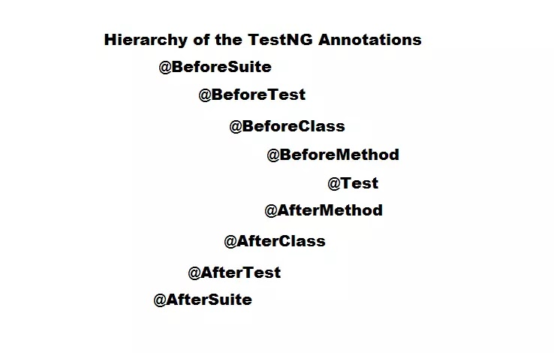
TestNG Annotations
TestNG Annotations
TestNG Annotations
TestNG Annotations are used to control the next method to be executed in the test script.
TestNG annotations are defined before every method in the test code.
In case any method is not prefixed with annotations, it will be ignored and not be executed as part of the test code.

Slide 9
TestNG Annotations (Contd.)
TestNG Annotations
TestNG Annotations Example:
Example:
@Test
Public void facebook()
{
driver.get(“https://facebook.com”);
driver.getTitle();
}

Slide 10
Types of TestNG Annotations
Please download pictures in suitable size here and insert them by clicking the symbol above.

Slide 11
Types of TestNG Annotations
Types of TestNG Annotations
@BeforeMethod : This will be executed before every @test annotated method.
@AfterMethod : This will be executed after every @test annotated method.
@BeforeClass : This will be executed before first @Test method execution. It will be executed one only time throughout the test case.
@AfterClass : This will be executed after all test methods in the current class have been run
@BeforeTest : This will be executed before the first @Test annotated method. It can be executed multiple times before the test case.
@AfterTest : A method with this annotation will be executed when all @Test annotated methods complete the execution of those classes inside the <test> tag in the TestNG.xml file.
@BeforeSuite :It will run only once, before all tests in the suite are executed.

Slide 12
Types of TestNG Annotations (Contd.)
Types of TestNG Annotations
@AfterSuite : A method with this annotation will run once after the execution of all tests in the suite is complete.
@BeforeGroups : This method will run before the first test run of that specific group.
@AfterGroups : This method will run after all test methods of that group complete their execution.

Slide 13
Types of TestNG Reporting
Please download pictures in suitable size here and insert them by clicking the symbol above.

Slide 14
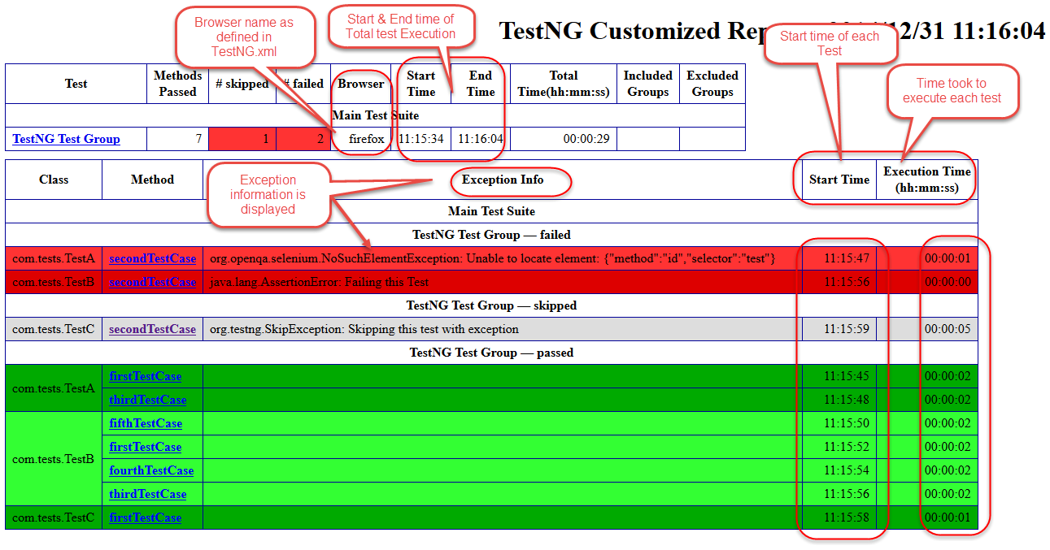
TestNG Reporting
TestNG Reporting
TestNG Reports are the default HTML reports which are generated once the testcases are executed using TestNG.
These reports help you to identify the information about the test cases and the status of a project.
TestNG reports in Selenium have three methods passTest, failTest and skipTest to check the data about the test cases.

Slide 15
TestNG Assertions
Please download pictures in suitable size here and insert them by clicking the symbol above.

Slide 16
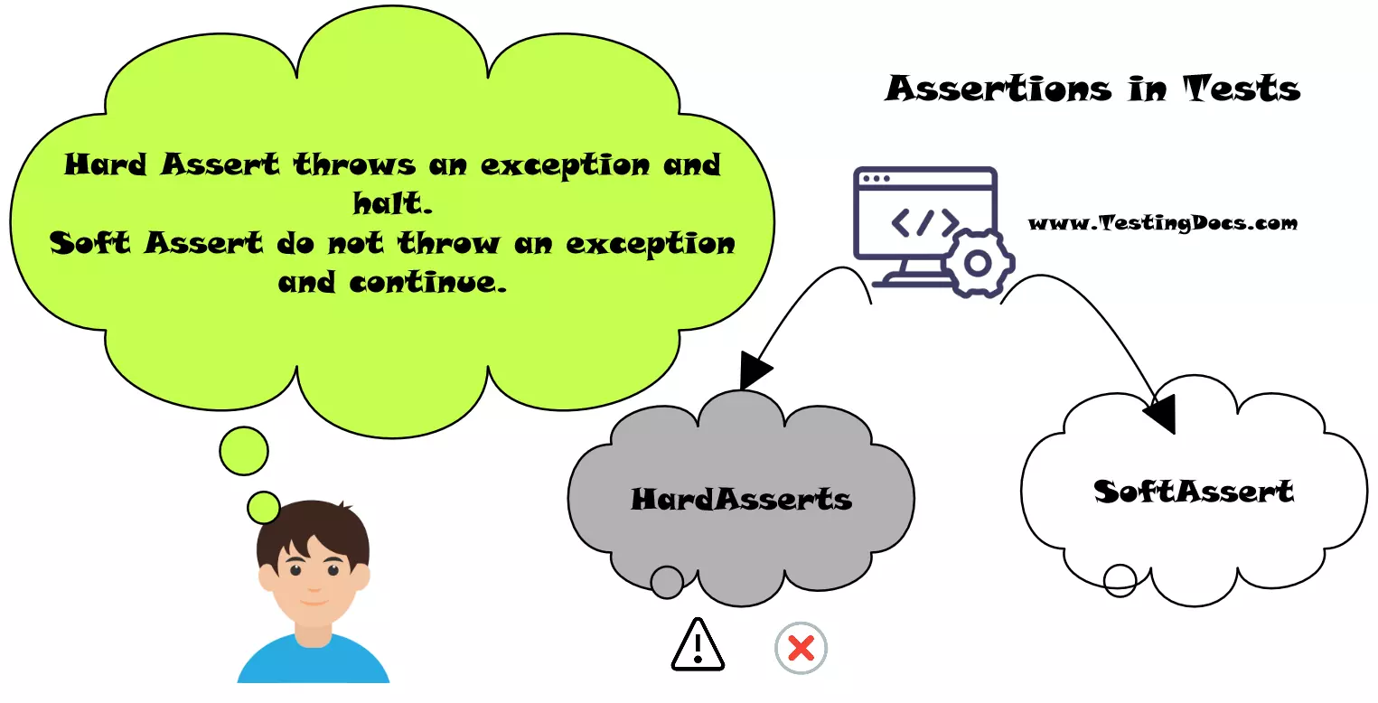
TestNG Assertions
TestNG Assertions
TestNG asserts are the most frequently used methods in TestNG and are so common that it is hard to find a TestNG code without the asserts.
TestNG asserts the tester decides whether the test was successful or not, along with the exceptions.
Syntax :
Assert.Method( actual, expected)

Slide 17
TestNG Assertions (Contd.)
TestNG Assertions
TestNG Assertions Example:
Example:
String expectedTitle = ”Facebook";
String originalTitle = driver.getTitle();
Assert.assertEquals(originalTitle, expectedTitle);

Slide 18
TestNG Suite and Parallel Execution
Please download pictures in suitable size here and insert them by clicking the symbol above.

Slide 19
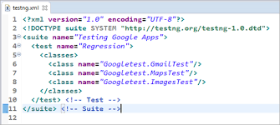
TestNG Suite
TestNG Suite and Parallel Execution
A test suite is a collection of test cases intended to test a behavior or a set of behaviors of software program
In TestNG, we cannot define a suite in testing source code, but it is represented by one XML file, as suite is the feature of execution
It is defined by the <suite> tag.

Slide 20
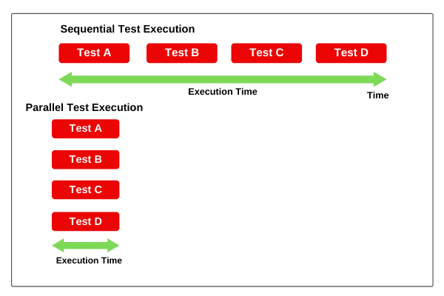
TestNG Parallel Execution
TestNG Suite and Parallel Execution
Parallel execution, as the name suggests, is a process of running the test case parallely rather than one after the other.
In parallel testing, the program ‘s multiple parts (or modules) execute together, saving the testers a lot of time and effort.
The operating systems functionalities do this, but as a user, we need to trigger the parallel execution through TestNG

Slide 21
TestNG Parallel Execution (Contd.)
TestNG Suite and Parallel Execution
Advantages of Parallel Testing:
Reduces Time
Allow Multi-Threaded Tests
Wider compatibility
Optimizes Continuous Integratiion and Delivery
Distributed Tests
Better test Coverage

Slide 22
TestNG Priority Execution
Please download pictures in suitable size here and insert them by clicking the symbol above.

Slide 23
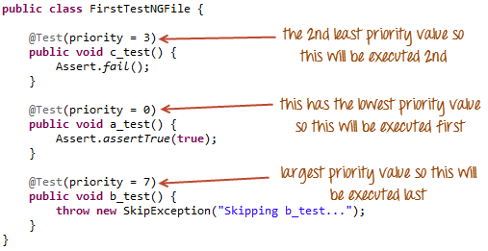
TestNG Priority Execution
TestNG Priority Execution
Prioritization in TestNG is a way to provide a sequence to the methods so that they do not run out of order
Providing priority to these test cases helps us managing our tests' execution.
The test methods with no priority assigned have a default priority equal to 0. It means if we define no priorities, all the test methods will be assigned priority 0, and a similar priority case will apply

Slide 24
TestNG Priority Execution (Contd.)
TestNG Priority Execution
The following is the syntax for allocating a priority to a test case method.
@Test (priority = 1)
public void func(){
//test code
}
Here the test method function has a priority of 1.

Slide 25
TestNG Priority Execution (Contd.)
TestNG Priority Execution
Points to remember regarding priority in TestNG:
Definition of Priority in TestNG test methods can only be the @Test methods.
Lower the priority number; higher is the priority of the test case method.
Priority in TestNG contains only integer value.
The value can be negative, zero, or positive.
If a tester defines a priority in decimal in TestNG, it needs to convert first to Integer (through typecasting).
One method is allowed to have only one priority in TestNG.
Priority cannot pass through the XML files.

Slide 26
Program 1
TestNG and its Types
public class NewTest { @Test public void f() { System.out.println("In Method"); } @BeforeMethod public void beforeMethod() { System.out.println("Before Method"); } @AfterMethod public void afterMethod() { System.out.println("After Method"); } @BeforeClass public void beforeClass() { System.out.println("Before Class"); }

Slide 27
Program 1 (Contd.)
TestNG and its Types
@AfterClass public void afterClass() { System.out.println("After Class"); } @BeforeTest public void beforeTest() { System.out.println("Before Test"); } @AfterTest public void afterTest() { System.out.println("After Test"); } @BeforeSuite public void beforeSuite() { System.out.println("Before Suite"); } @AfterSuite public void afterSuite() { System.out.println("After Suite"); } }

Slide 28
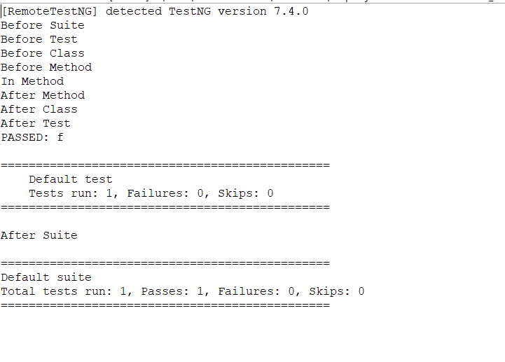
Output
TestNG and its Types

Slide 29
Program 2
TestNG and its Types
public class Dependencytest { @Test(priority=0,enabled=false) public void agecheck() { System.out.println("Checks for age eligibility"); } @Test(priority=1,dependsOnMethods="agecheck") public void qualificationcheck() { System.out.println("checks for qualification"); } @Test(priority=2,dependsOnMethods="qualificationcheck") public void admit_approval() { System.out.println("Decides the approval of candidate admission based on age and qulaification"); } }

Slide 30
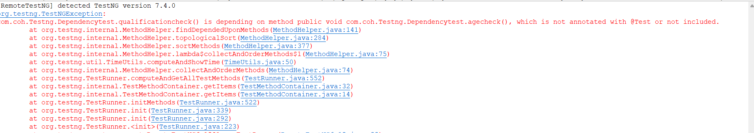
Output
TestNG and its Types

Slide 31
Program 3
TestNG and its Types
public class GroupDemo { @Test(groups={"Athlete"}) public void athletes1() { System.out.println("Athletics group1");} @Test(groups={"Athlete"}) public void athletes2() { System.out.println("Athletics group2"); } @Test(groups={"Martial"}) public void martial_arts1() { System.out.println("Martial arts1"); }

Slide 32
Program 3 (Contd.)
TestNG and its Types
@Test(groups={"Martial"}) public void martial_arts2() { System.out.println("Martial arts2"); } @Test(groups={"NetGames"}) public void netted_games1() { System.out.println("netted games1"); } @Test(groups={"NetGames"}) public void netted_games2() { System.out.println("netted games2");}

Slide 33
Program 3 (Contd.)
TestNG and its Types
@Test(groups={"WaterGames"}) public void water_games1() { System.out.println("water games1"); } @Test(groups={"WaterGames"}) public void water_games2() { System.out.println("water games1");} }

Slide 34
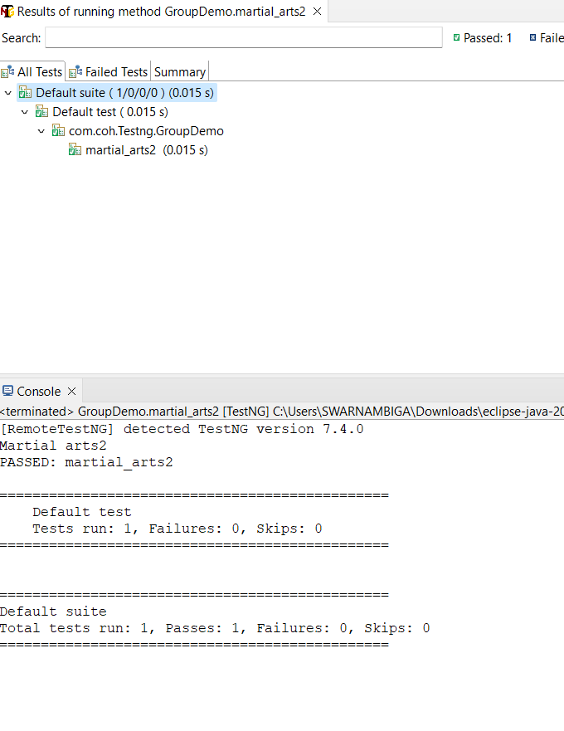
Output
TestNG and its Types

Slide 35
Program 4
TestNG and its Types
public class Skip_testcase { @Test(priority=0,enabled=false) public void start() { System.out.println("Start the veheicle"); } @Test(priority=1) public void gear1() { System.out.println("gear1"); } @Test(priority=2) public void gearchange() { System.out.println("Gear change"); }

Slide 36
Program 4 (Contd.)
TestNG and its Types
@Test(priority=3,enabled=false) public void playsong() { System.out.println("play music"); } }

Slide 37
Program 4 (Contd.)
TestNG and its Types
<?xml version="1.0" encoding="UTF-8"?> <suite name="Test Suite2"> <test name="Test cases2"> <groups> <run> <include name="Athlete"></include> <include name="Martial_arts"></include> </run> </groups> <classes><class name="com.coh.Testng.GroupDemo"> </class> </classes> </test> </suite>

Slide 38
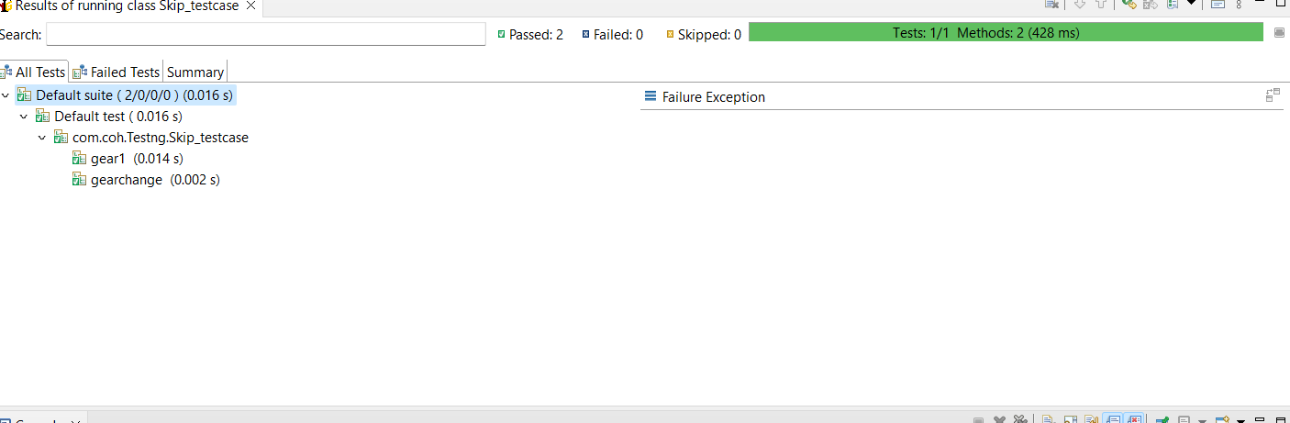
Output
TestNG and its Types

Slide 39
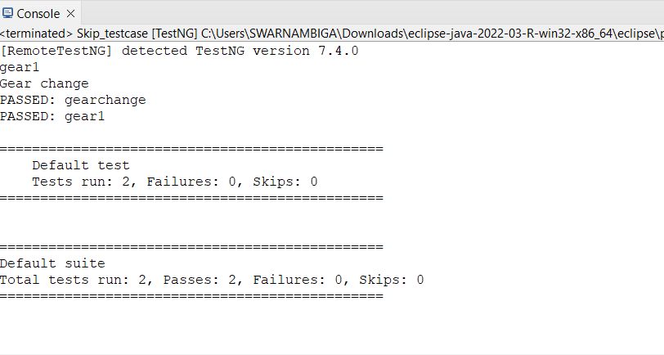
Output
TestNG and its Types

Slide 40
Program 5
TestNG and its Types
public class Parameterdemo1 { @Test @Parameters("Subject") public void display(String subject1) { System.out.println("Subject Selected:"+subject1); } }

Slide 41
Program 5 (Contd.)
TestNG and its Types
<?xml version="1.0" encoding="UTF-8"?> <!DOCTYPE suite SYSTEM "http://testng.org/testng-1.0.dtd" > <suite name="Test Suite1" verbose="2" parallel="methods" thread-count="2" > <test name="Test cases1"> <parameter name="Name" value="Artificial Intelligence"></parameter> <classes> <class name="com.coh.Testng.Parameterdemo"> <!-- <class name="com.coh.Testng.Paralleledemo2"> --> </class> </classes> </test> </suite>

Slide 42
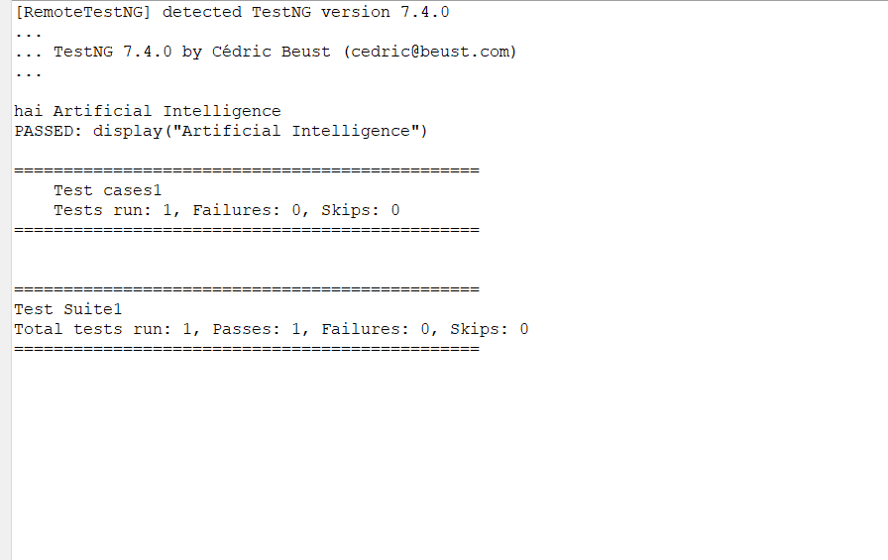
Output
TestNG and its Types

Slide 43
Program 6
TestNG and its Types
public class Listeners2 implements ITestListener{ @Override public void onFinish(ITestContext arg0) { // TODO Auto-generated method stub System.out.println("On test finish"); } @Override public void onStart(ITestContext arg0) { // TODO Auto-generated method stub System.out.println("On Start"); }

Slide 44
Program 6 (Contd.)
TestNG and its Types
@Override public void onTestFailedButWithinSuccessPercentage(ITestResult arg0) { // TODO Auto-generated method stub System.out.println("on TestFailed But Within SuccessPercentage");} @Override public void onTestFailure(ITestResult arg0) { // TODO Auto-generated method stub System.out.println("on Test Failure");} @Override public void onTestSkipped(ITestResult arg0) { // TODO Auto-generated method stub System.out.println("on Test Skipped");}

Slide 45
Program 6 (Contd.)
TestNG and its Types
@Override public void onTestStart(ITestResult arg0) { // TODO Auto-generated method stub System.out.println("on Test Start"); } @Override public void onTestSuccess(ITestResult arg0) { // TODO Auto-generated method stub System.out.println("on Test Success"); } }

Slide 46
Program 6 (Contd.)
TestNG and its Types
<?xml version="1.0" encoding="UTF-8"?> <!DOCTYPE suite SYSTEM "http://testng.org/testng-1.0.dtd" > <suite name="Test Suite2" verbose="2"> <listeners> <listener class-name="com.coh.Testng.Listeners2"></listener> </listeners> <test name="Test cases2"> <classes> <class name="com.coh.Testng.Testng1"> </class> </classes> </test> </suite>

Slide 47
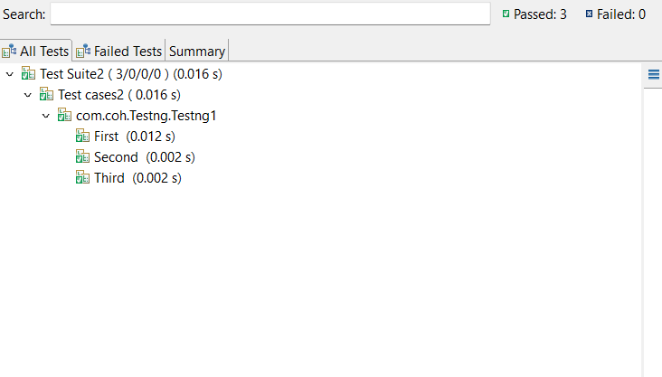
Output
TestNG and its Types

Slide 48
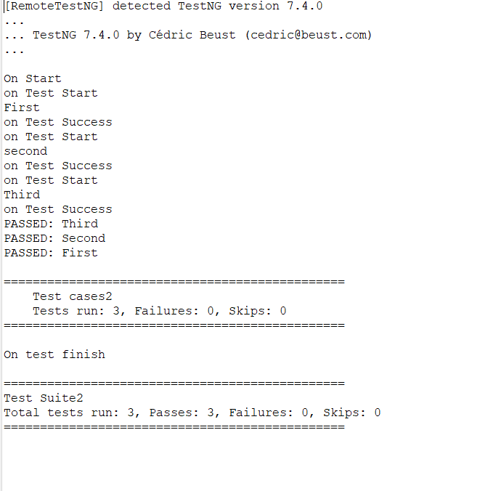
Output
TestNG and its Types

Slide 49

Quiz
Computational Thinking
Which of the following is a TestNG report?
a) Testcase report
b) Test suite report
c) Emailable report
d) Failure report
Answer : Option c)

Slide 50
Quiz
Computational Thinking
Is the statement true: TestNG uses the method of alphabetical execution to execute its test method.
a) True
b) False
c) Both a and b
d) Not a nor b
Answer : Option a)

Slide 51
Quiz
Computational Thinking
Which tag is used to run tests in a group in TestNG?
a) execute
b) Run
c) add
d) include
Answer : Option b)

Slide 52
Quiz
Computational Thinking
Parallel testing can be applied at
a) Methods
b) Tests
c) Classes
d) All the above
Answer : Option d)

